Slide 1

Natural Language Processing DLO 8012
Subject In-charge
Ms Vincy Joseph
Assistant Professor
email: vincyjoseph@sfit.ac.in

Slide 2
Module VI
Lecture 31 Applications of NLP

Slide 3
Machine Translation

Slide 4
Approaches to Machine Translation
MT is classified into seven broad categories:
rule-based
knowledge-based
principle-based
statistical-based
hybrid-based
example-based
online interactive based methods.

Slide 5
4.Empirical MT (EMT) Systems
EMT systems rely on large parallelly aligned corpora.
Empirical systems acquire the knowledge about set of rules describing the translation process automatically from a collection of translation examples.
It uses automatically induced rules.
2 Categories : Statistical and Example-Based

Slide 6
4.1 Statistical-based Approach
Translation is based on the knowledge and statistical models extracted from bilingual corpora.
It requires bilingual or multilingual textual corpora of the source and target language(s) are required.
A supervised or unsupervised ML algorithm is used to build statistical tables from the corpora.
The statistical tables consist of
the characteristics of well-formed sentences, and
the correlation between the languages.

Slide 7
4.1 Statistical-based Approach
During translation, the collected statistical information is used to find the best translation for the input sentences, and this translation step is called the decoding process.
There are three different statistical approaches in MT named :
Word-based Translation
Phrase-based Translation
Hierarchical Phrase-based model.
The idea behind SMT comes from information theory.
A document is translated according to the probability distribution function indicated by p(e|f), which is the probability of translating a sentence f in the SL (F) to a sentence e in the TL(E).

Slide 8
4.1 Statistical-based Approach
The problem of modeling the probability distribution p(e|f) has been approached in a number of ways.
One intuitive approach is to apply Bayes theorem.
If p(f|e) indicate translation model and p(e) indicate language model then the probability distribution
p(e|f) ∞ p(f|e)p(e).
The translation model p(f|e) is the probability that the source sentence is the translation of the target sentence or the way sentences in E get converted to sentences in F.
The language model p(e) is the probability of seeing that TL string or the kind of sentences that are likely in the language E.

Slide 9

4.1 Statistical-based Approach
This decomposition is attractive as it splits the problem into two sub problems.
Finding the best translation is done by picking the one that gives the highest probability, as shown in equation below.

Slide 10
4.1 Statistical-based Approach
Drawback of phrase based models :
They do not handle syntax in a natural way.
Reordering of phrases during translation is managed by distortion models in SMT.
This reordering process is entirely unsatisfactory, especially for language pairs that differ a lot in terms of word-order.
E.g. I like you >>>Hindi
This problem of structural differences between source and target languages can be solved with a reordering task.

Slide 11
4.1.1 Word-based Translation
Here, the words in an input sentence are translated word by word individually, and these words finally are arranged in a specific way to get the target sentence.
This approach is the very first attempt in the statistical-based MT system
This is comparatively simple and efficient.
Disadvantage: It reduce the performance of the translation system.

Slide 12
4.1.2 Phrase-based Translation
It is a more accurate SMT approach
Here, each sentence is divided into separate phrases instead of words.
The alignment between the phrases in the input and output sentences normally follows certain patterns.
It resulted in better performance than the word-based translation
But it did not improve the model of sentence order patterns.
The reordering technique may perform well with local phrase orders but not as well with long sentences and complex orders.

Slide 13
4.1.3 Hierarchical Phrase-based Model
The advantage of this approach is that hierarchical phrases have recursive structures instead of simple phrases.
This higher level of abstraction approach further improved the accuracy of the SMT system.

Slide 14
4.2 Example Based MT (EBMT)
It is based on analogical reasoning between two translation examples.
It relies on large parallel aligned corpora.
An EBMT system is given a set of sentences in the SL and their corresponding translations in the TL, and uses those examples to translate other, similar SL sentences into the TL.
The basic logic is that, if a previously translated sentence occurs again, the same translation is likely to be correct again.
EBMT systems are attractive in that they require a minimum of prior knowledge; therefore, they quickly adapt to many language pairs.

Slide 15
4.2 Example Based MT
A restricted form of example-based translation is available commercially, known as a translation memory.
In a translation memory, as the user translates text, the translations are added to a database, and when the same sentence occurs again, the previous translation is inserted into the translated document.
This saves the user the effort of re-translating that sentence
More advanced translation memory systems will also return close but inexact matches on the assumption that editing the translation of the close match will take less time than generating a translation from scratch.

Slide 16
4.2 Example Based MT
Eg.
ALEPH : Aleph is company incorporated in Qatar with an international network of professional linguists offering a variety of translation services
wEBMT : Machine Translation System Using the World Wide Web
PanEBMT : Made by Carnegie Mellon University

Slide 17
5. Online Interactive MT
In this interactive translation system, the user is allowed to suggest the correct translation to the translator online.
This approach is very useful in a situation where the context of a word is unclear and there exists many possible meanings for a particular word.
In such cases, the structural ambiguity can be solved with the interpretation of the user.

Slide 18
6. Hybrid MT
Takes advantage of both statistical and rule-based translation methodologies
It is more efficient
These systems are based on both rules and statistics.
Hybrid approach can be used in different ways:
Translations are performed in the first stage using a rule-based approach followed by adjusting or correcting the output using statistical information
In the other way, rules are used to pre-process the input data as well as post-process the statistical output of a statistical-based translation system. This technique is better and has more power, flexibility, and control in translation.

Slide 19
6. Hybrid MT
Example:
METIS-II MT system is an example of hybridization which avoids the usual need for parallel corpora by using a bilingual dictionary and a monolingual corpus in the TL.
Oepen MT System: It integrates statistical methods within an RBMT system to choose the best translation from a set of competing hypotheses (translations) generated using rule-based methods.

Slide 20
Rule Based Machine Translation (RBMT) System
Having input sentences (in some SL), an RBMT system generates them to output sentences (in some TL) on the basis of morphological, syntactic, and semantic analysis of both the source and the target languages involved in a concrete translation task.
It applies a set of linguistic rules in three different phases: analysis, transfer and generation.
It requires: syntax analysis, semantic analysis, syntax generation and semantic generation.

Slide 21
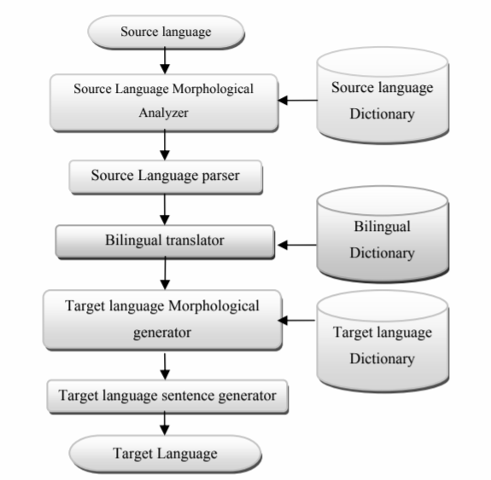
RBMT System
RBMT generates the target text given a source text in the following the steps

Slide 22
RBMT System
Source language morphological analyzer analyzes a source language word and provides the morphological information.
Source language parser is a syntax analyzer that analyzes source language sentences.
Translator is used to translate a source language word into target language. (Word Translation)
Target language morphological analyzer works as a generator and it generates appropriate target language words for the given grammatical information.
Also target language parser works as a composer and it composes a suitable target language sentence.

Slide 23
RBMT System
This type of MTsystem needs a minimum of three dictionaries:
Source Language Dictionary: It is used by SL morphological analyzer
Bilingual Dictionary: It is used by the translator for translating source language into target language
Target Language Dictionary: It is used by morphological to generate target language words.

